Slide 1
PREDICTING
Credit Card Defaults
Using Machine Learning Techniques
BFOR 516 – Advanced Data Analytics for Cybersecurity | Spring 2026
Spencer Kone
Muhammad H. Bahar
Kunapureddy Leela Pavan Kumar
Maddirala Shalem Raju
Faculty: Dr. Srishti Gupta | Group 3
Notes:
============================================================
PRESENTER: Maddirala Shalem Raju
============================================================
SPEAKER NOTES – Slide 1: Title
Opening statement: 'Today we present our analysis of credit card default prediction using three machine learning models on 30,000 real-world client records from Taiwan.'
Group 3 members: Spencer Kone, Muhammad H. Bahar, Kunapureddy Leela Pavan Kumar, Maddirala Shalem Raju
ANTICIPATED PROFESSOR QUESTIONS:
Q: What was the division of labor in the group?
A: [Briefly describe each member's contribution — EDA, modeling, visualization, report writing]

Slide 2
WHY THIS MATTERS
The Problem & Stakes
Financial Risk
Class Imbalance
Credit defaults cost banks billions annually — predicting them early prevents major losses
Only 22% of clients default, making prediction harder — the model must detect the minority
Real-World Dataset
Multiple Metrics
30,000 Taiwan credit card clients from UCI ML Repository — real behavior, real stakes
Accuracy alone is misleading — recall matters most since missing a defaulter is costlier
Notes:
============================================================
PRESENTER: Kunapureddy Leela Pavan Kumar
============================================================
SPEAKER NOTES – Slide 2: Why This Matters
Connect to cybersecurity context:
• Credit default prediction is a financial risk ML problem, directly applicable to fraud detection and anomaly scoring in cyber domains
• The same feature engineering, model selection, and evaluation methodology applies to intrusion detection, insider threat scoring
• Class imbalance (22% default) mirrors real cyber threat datasets (attacks are rare events)
ANTICIPATED PROFESSOR QUESTIONS:
Q: Why is this a BFOR 516 topic?
A: Advanced data analytics for cybersecurity covers ML techniques applicable to risk. Credit default prediction uses the same methodology as behavioral anomaly detection — identifying rare, high-cost events in imbalanced datasets.

Slide 3
Dataset at a Glance
Default of Credit Card Clients | UCI Machine Learning Repository | Yeh & Lien (2009)
30,000
23
22.12%
Client Records
Features
Default Rate
3.5:1
NT$167K
35 yrs
Class Imbalance
Avg Credit Limit
Average Age
Notes:
============================================================
PRESENTER: Muhammad H. Bahar
============================================================
SPEAKER NOTES – Slide 3: Dataset at a Glance
Key facts to emphasize:
• 30,000 credit card clients in Taiwan (April–September 2005), sourced from UCI ML Repository
• 23 features: demographics (age, sex, education, marriage), credit limit, 6-month payment history, bill amounts, payment amounts
• Default rate = 22.12% → 22,364 No Default vs 6,636 Default clients
• Class imbalance of 3.5:1 requires special handling (class_weight='balanced')
• Average credit limit NT$167,484 | Average age 35 years
ANTICIPATED PROFESSOR QUESTIONS:
Q: Why is this dataset relevant to cybersecurity?
A: Financial fraud and credit default prediction are core cyber-risk problems. The same ML techniques apply to anomaly detection, insider threat scoring, and fraud detection in banking systems.
Q: Is the dataset still representative today (2005 data)?
A: The behavioral patterns — payment delay as a predictor — are time-stable. The paper by Yeh & Lien (2009) has 4,000+ citations confirming its continued relevance as a benchmark.

Slide 4
Data Preparation & Cleaning
DATA CLEANING
PREPROCESSING PIPELINE
01
Initial Inspection
04
Stratified Train/Test Split
30,000 rows × 24 cols, all int64
0 missing values — 35 duplicate rows kept
80/20 split (random_state=42, stratify=y)
Default rate 22.12% preserved in both sets
02
EDUCATION Cleaning
05
StandardScaler Normalization
Values 0, 5, 6 undocumented → remapped to 4
345 rows affected (1.15%)
Fitted on train only → applied to both sets
Prevents data leakage from test set
03
MARRIAGE Cleaning
Value 0 undocumented → remapped to 3
54 rows affected. Total cleaned: 399 rows (1.3%)
Result: 30,000 clean records • 399 rows corrected (1.3%) • 24,000 train / 6,000 test • No data leakage
Notes:
============================================================
PRESENTER: Muhammad H. Bahar
============================================================
SPEAKER NOTES – Slide 4: Data Preparation & Cleaning
Walk through each step:
1. Initial Inspection: 30,000 rows × 24 cols, all int64. Zero missing values. 35 duplicates retained (0.12%)
2. EDUCATION: Values 0, 5, 6 not in original codebook → remapped to 4 (Other). Affected 345 rows (1.15%)
3. MARRIAGE: Value 0 undocumented → remapped to 3 (Other). Affected 54 rows. Total cleaned: 399 rows (1.3%)
4. Stratified 80/20 split: 24,000 train / 6,000 test. Stratification ensures 22.12% default rate in both sets
5. StandardScaler fit ONLY on training data → transforms test set using train statistics. Prevents data leakage
ANTICIPATED PROFESSOR QUESTIONS:
Q: Why not drop the undocumented EDUCATION/MARRIAGE values?
A: 399 rows is 1.3% of the dataset. Dropping would waste valid data. Remapping to 'Other' is the standard approach recommended in the original paper.
Q: What is data leakage and how did you prevent it?
A: Data leakage means the model sees test-set information during training. We prevented it by fitting StandardScaler only on X_train, then applying transform() (not fit_transform()) on X_test.

Slide 5
Model Selection Rationale
BASELINE
PROBABILISTIC
BEST MODEL
Logistic Regression
Gaussian Naive Bayes
Decision Tree
WHY CHOSEN
WHY CHOSEN
WHY CHOSEN
Industry-standard in finance; interpretable coefficients show feature impact on default probability
Probabilistic approach using Bayes theorem — good contrast to deterministic LR
Captures non-linear relationships without requiring feature scaling
LIMITATION
LIMITATION
LIMITATION
Assumes linear separability — violated here (PCA shows class overlap)
Assumes feature independence — violated (PAY_AMT1–6 correlations > 0.9)
Prone to overfitting — controlled with max_depth=5, min_samples_leaf=20
KEY FIX
KEY FIX
KEY FIX
class_weight='balanced' to counter 3.5:1 imbalance
No class_weight support; expected lower performance
Gini impurity as criterion; class_weight='balanced' applied
Notes:
============================================================
PRESENTER: Muhammad H. Bahar
============================================================
SPEAKER NOTES – Slide 5: Model Selection Rationale
Explain WHY these three models:
• Logistic Regression: Gold standard binary classifier in finance. Coefficients directly interpretable (positive = higher default probability). class_weight='balanced' adds weight to minority class
• Gaussian Naive Bayes: Fastest to train. Provides a probabilistic benchmark. Assumption of feature independence is violated here (PAY_AMT columns correlate >0.9) — useful as a lower bound
• Decision Tree (max_depth=5): Captures non-linear relationships that LR cannot. Built-in feature importance. Controlled with min_samples_leaf=20 to prevent overfitting on 30K rows
ANTICIPATED PROFESSOR QUESTIONS:
Q: Why not use more powerful models like Random Forest or XGBoost?
A: This milestone focused on interpretable baseline models. Random Forest was tested in the final stage. The assignment scope specified these three. Decision Tree at depth 5 is already an ensemble-adjacent approach with regularization.
Q: Why use class_weight='balanced' instead of SMOTE?
A: class_weight is computationally cheaper and built into sklearn. SMOTE was tested in the final stage (Milestone 4) as a separate improvement step.

Slide 6
Evaluation Framework
Why we used multiple metrics — accuracy alone is misleading with 78/22 class split
★ HIGHEST PRIORITY
SECONDARY
BALANCE METRIC
Recall (Default class)
Precision (Default class)
F1-Score
Missing a real defaulter is the most costly error for the bank — false negatives mean undetected risk
Also important — too many false positives rejects creditworthy customers unnecessarily
Harmonic mean of precision & recall — single score that penalises extreme imbalance between the two
PRIMARY COMPARISON
RELIABILITY CHECK
ROC-AUC
5-Fold Stratified CV
Measures discrimination ability across ALL decision thresholds — robust to class imbalance, main ranking metric
Each fold preserves the 22.12% default rate — guards against lucky/unlucky single splits and measures model stability
Notes:
============================================================
PRESENTER — TECHNICAL LEAD: Spencer Kone
============================================================
SPEAKER NOTES – Slide 6: Evaluation Framework
Explain each metric's role:
• Recall (Default class) — HIGHEST PRIORITY: If the model misses a real defaulter (False Negative), the bank loses money. LR achieved best recall = 0.6202
• Precision: Of all clients flagged as defaulters, how many actually are? LR precision = 0.3671 — too many false positives
• F1-Score: Harmonic mean balances precision and recall. DT best F1 = 0.5173
• ROC-AUC: Measures discrimination across ALL thresholds. DT best AUC = 0.7589
• 5-Fold CV AUC: DT CV = 0.7577 ± 0.0067 — confirms stable generalization
ANTICIPATED PROFESSOR QUESTIONS:
Q: Is accuracy a valid metric here?
A: No. With 78% non-default, a model predicting all 'no default' scores 78% accuracy but is useless. That's why we prioritize recall, F1, and AUC.
Q: How do you choose the right decision threshold?
A: Default threshold is 0.5. For risk applications, lowering the threshold (e.g., 0.3) increases recall at the cost of precision. The ROC curve shows the full tradeoff.

Slide 7
Model Performance Results
6,000-sample stratified test set | * Metrics for Default (1) class
Model | Accuracy | Precision* | Recall* | F1-Score* | ROC-AUC | CV AUC (5-fold)
Logistic Regression | 0.6795 | 0.3671 | 0.6202 | 0.4612 | 0.7084 | 0.7264 ± 0.011
Gaussian Naive Bayes | 0.7518 | 0.4504 | 0.5539 | 0.4968 | 0.7248 | 0.7365 ± 0.010
Decision Tree ✓ | 0.7723 | 0.4870 | 0.5516 | 0.5173 | 0.7589 | 0.7577 ± 0.007
BEST F1
BEST AUC
BEST RECALL
LOWEST CV VARIANCE
0.5173
0.7589
0.6202
±0.007
Decision Tree
Decision Tree
Logistic Regression
Decision Tree – most stable
Notes:
============================================================
PRESENTER — TECHNICAL LEAD: Spencer Kone
============================================================
SPEAKER NOTES – Slide 7: Model Performance Results
Full metric table (Default class):
Model Acc Prec Rec F1 AUC CV
------------------------------------------------------------
Logistic Regression 0.6795 0.3671 0.6202 0.4612 0.7084 0.7264
Naive Bayes 0.7518 0.4504 0.5539 0.4968 0.7248 0.7365
Decision Tree 0.7723 0.4870 0.5516 0.5173 0.7589 0.7577
Key talking points:
• DT wins on F1 (0.5173), AUC (0.7589), accuracy (0.7723), and CV stability (±0.0067)
• LR wins on recall (0.6202) — catches more defaulters but with too many false alarms
• NB is middle ground — acceptable AUC (0.7248) but feature independence assumption hurts it
ANTICIPATED PROFESSOR QUESTIONS:
Q: Decision Tree has only 55% recall — it misses 45% of defaulters. Is that acceptable?
A: It's a tradeoff. DT has the best balanced F1 (0.5173) and AUC (0.7589). LR's higher recall (0.6202) comes at the cost of precision (0.3671) — it flags 63% of non-defaulters incorrectly.
Q: How do these results compare to state-of-the-art?
A: Yeh & Lien (2009) report AUC ~0.72 for neural nets on this dataset. Our DT achieves 0.7589 — competitive. More advanced models (XGBoost) typically reach 0.78–0.82.

Slide 8
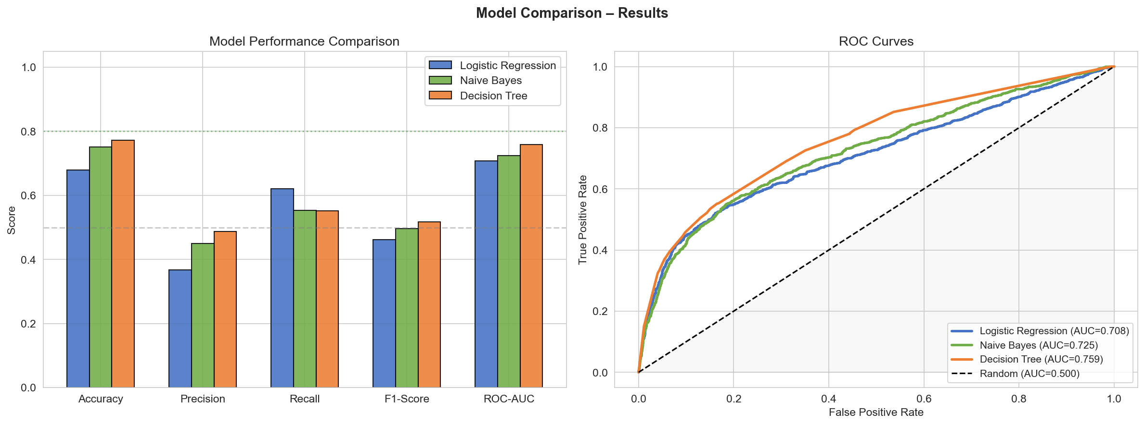
Visual Performance Comparison
Notes:
============================================================
PRESENTER — TECHNICAL LEAD: Spencer Kone
============================================================
SPEAKER NOTES – Slide 8: Visual Performance Comparison
Walk through the two charts:
LEFT — Bar chart: Decision Tree (orange) leads on Accuracy, F1, and AUC. LR (blue) leads on Recall but lags on Precision and Accuracy.
RIGHT — ROC curves: All three models beat the random baseline (dashed diagonal).
• DT AUC = 0.7589 — best curve, hugs top-left corner most
• NB AUC = 0.7248
• LR AUC = 0.7084
ANTICIPATED PROFESSOR QUESTIONS:
Q: What does the area under the ROC curve actually mean?
A: AUC = probability that the model ranks a random defaulter higher than a random non-defaulter. AUC=0.50 is random guessing; AUC=1.0 is perfect. Our DT at 0.7589 means it correctly ranks 75.9% of such pairs.
Q: Why do the three ROC curves cross each other?
A: Each model has a different tradeoff profile. At low FPR thresholds, NB may outperform LR; at high FPR, LR catches more positives. The AUC summarizes performance across all thresholds.

Slide 9
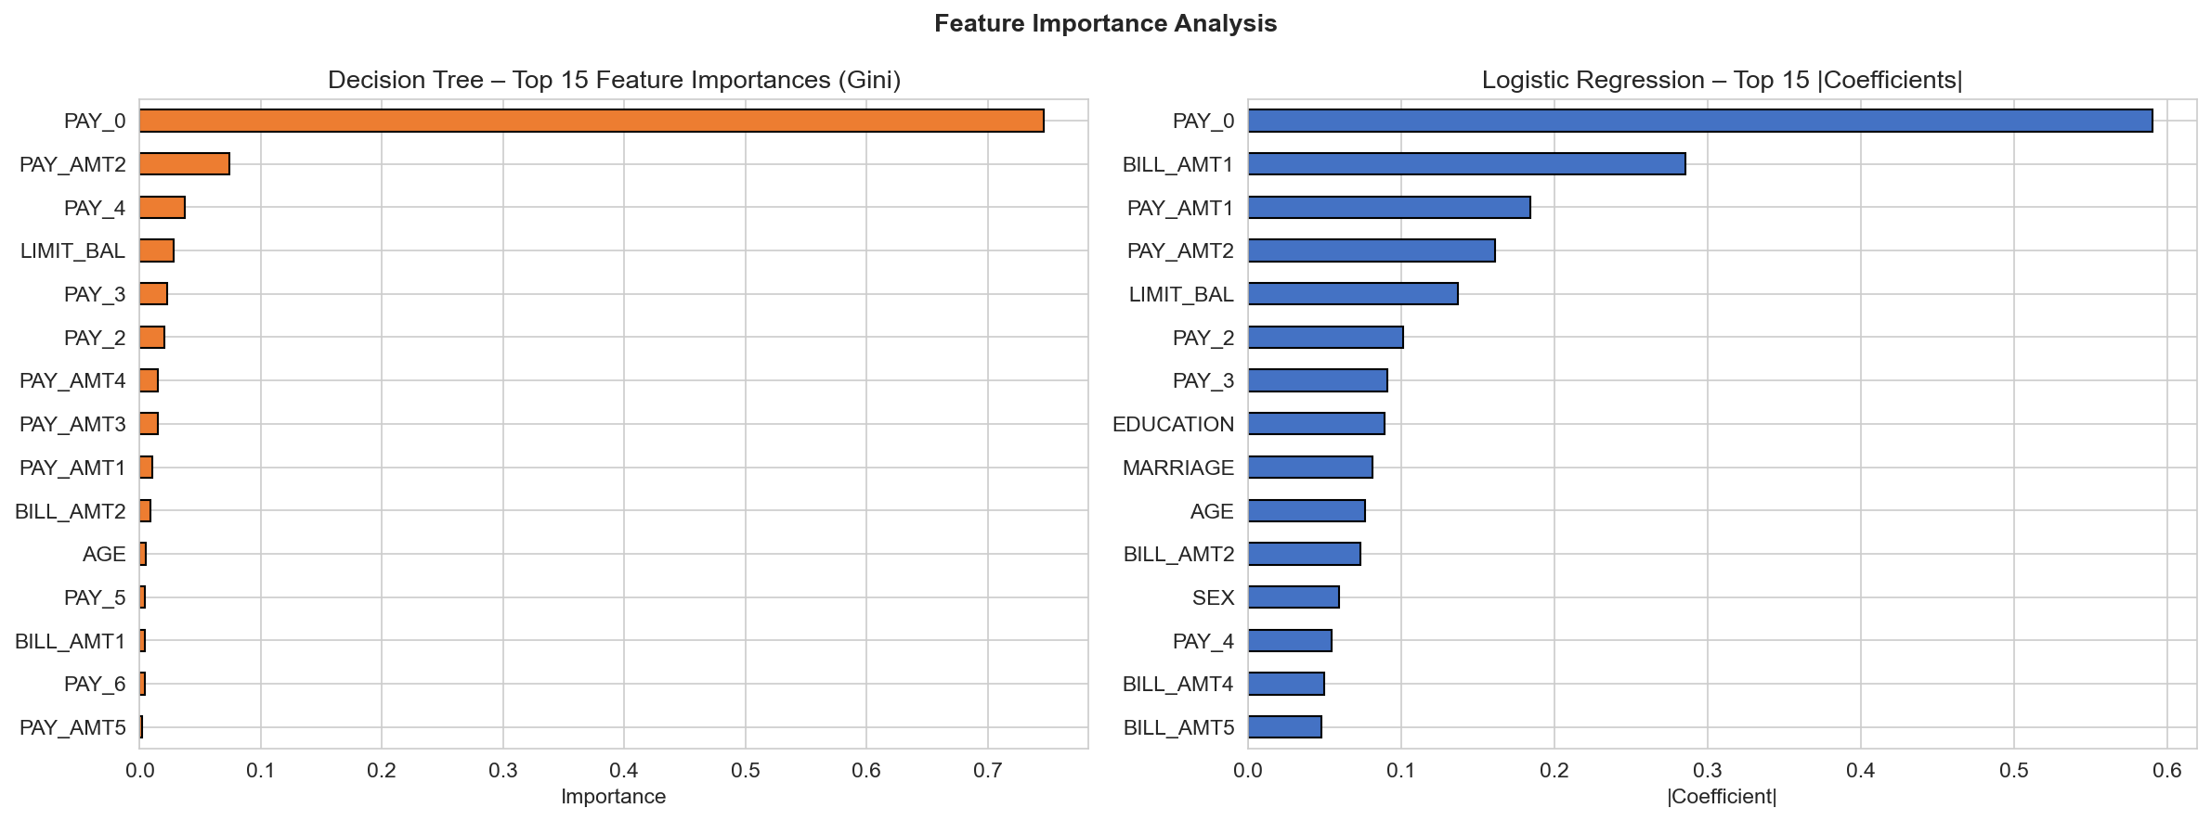
The Dominant Predictor: PAY_0
Decision Tree — Gini Feature Importance | PAY_0 = most recent month repayment status
74.61%
PAY_0 Gini Importance
More than all other 22 features combined
Top 3
All payment history vars
PAY_0, PAY_AMT2, PAY_4
✓ Verified
Yeh & Lien (2009)
Original paper confirmed same finding
If you paid late last month → you're likely to default next month.
Notes:
============================================================
PRESENTER — TECHNICAL LEAD: Spencer Kone
============================================================
SPEAKER NOTES – Slide 9: Feature Importance
Key insight: PAY_0 = 74.61% of all DT split importance — more than all 22 other features combined.
Top 3 features: PAY_0 (74.6%), PAY_AMT2 (7.4%), PAY_4 (3.7%)
Interpretation:
• PAY_0 = September payment status (-1=paid on time, 0=revolving, 1-8=months delayed)
• Clients who were even 1 month late in September have dramatically higher default probability
• Payment amounts matter more than bill amounts — whether you paid, not how much you owe
• Demographics (age, sex, education) have near-zero importance
LR Coefficients (right chart): PAY_0 also dominates. LIMIT_BAL has a negative coefficient — higher credit limit → lower default risk.
ANTICIPATED PROFESSOR QUESTIONS:
Q: Does PAY_0 dominating mean the other features are useless?
A: Not entirely. They contribute to edge cases. But PAY_0 alone at the root split cleanly separates ~75% of cases. This is consistent with behavioral finance: recent payment behavior is the strongest signal of future behavior.
Q: Could there be multicollinearity issues with the payment history features?
A: Yes — PAY_0 through PAY_6 are correlated (r≈0.5–0.7). This hurts LR coefficient interpretation but not DT importance, since DT selects the best single split at each node.

Slide 10
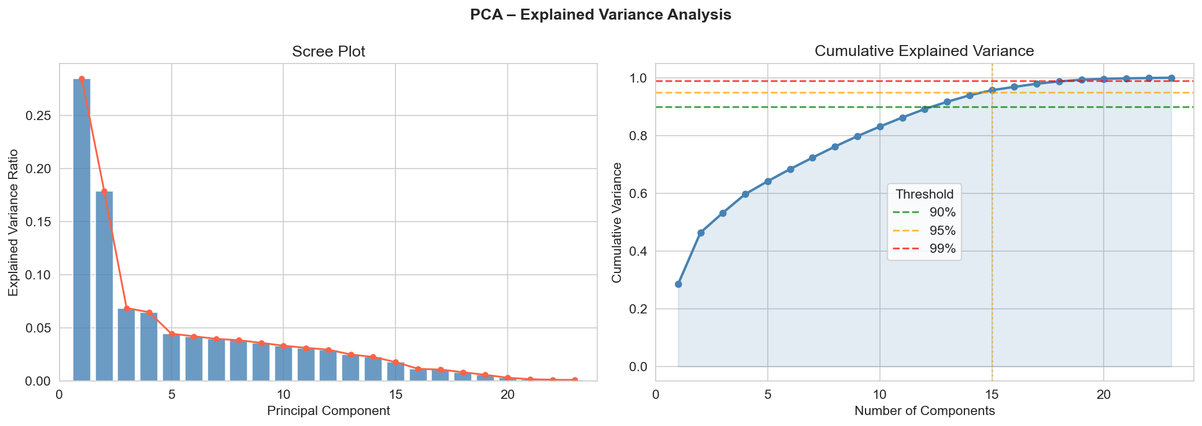
PCA & Dimensionality Insights
Variance Thresholds
90% variance
→ 13 components needed
95% variance
→ 15 components needed
99% variance
→ 19 components needed
What this tells us:
• Dataset has moderate correlations — not strongly reducible • Classes overlap in 2D PCA space — confirms non-linear boundaries • Explains why Decision Tree outperforms Logistic Regression
Notes:
============================================================
PRESENTER — TECHNICAL LEAD: Spencer Kone
============================================================
SPEAKER NOTES – Slide 10: PCA & Dimensionality Insights
PCA was run on standardized training features (23 features).
Results:
• 90% variance → 13 components (vs 23 original)
• 95% variance → 15 components
• 99% variance → 19 components
• Top 5 PCs explain 64.2% of variance
2D scatter (fig_07): Classes significantly overlap → confirms linear boundaries are insufficient.
What this tells us:
• Dataset has moderate correlations — not strongly reducible like image data
• Non-linear models (DT) have an inherent advantage over LR here
• Dimensionality reduction via PCA would sacrifice meaningful variance without large accuracy gain
ANTICIPATED PROFESSOR QUESTIONS:
Q: Did you use PCA as input to your models?
A: No — we used it diagnostically to understand the feature space. For LR and NB, we used all 23 scaled features. Using PCA components as model input would reduce interpretability without meaningful performance gain.
Q: What does class overlap in PCA space tell you about model selection?
A: If classes were linearly separable in PCA space, LR would excel. The overlap confirms that decision boundaries are non-linear, which is why Decision Tree outperforms Logistic Regression.

Slide 11
Critical Analysis & Lessons
LR
Logistic Regression
NB
Gaussian Naive Bayes
Highest recall (0.62) — finds most defaulters
Moderate all-round but worst accuracy (0.75)
But very low precision (0.37) — flags too many non-defaulters. Class imbalance handling essential.
Feature independence assumption strongly violated — correlations in PAY_AMT columns hurt performance significantly.
DT
Decision Tree (Winner)
★
Overall Project Lesson
Best F1 (0.5173), best AUC (0.7589), most stable CV
Recent behavior > demographics > historical averages
Non-linearity captured well. Gini impurity reveals PAY_0 dominance. Controlled depth prevents overfitting.
PAY_0 alone contributes 74.6% of split importance. Banks should weight current-month payment status highest.
Notes:
============================================================
PRESENTER — TECHNICAL LEAD: Spencer Kone
============================================================
SPEAKER NOTES – Slide 11: Critical Analysis & Lessons
LR Analysis:
• Highest recall (0.6202) — catches most actual defaulters
• But precision only 0.3671 — 63% of its 'default' predictions are wrong
• class_weight='balanced' pushed it toward recall at the cost of precision
NB Analysis:
• Moderate AUC (0.7248) despite the independence assumption violation
• PAY_AMT columns have correlations >0.9 — NB treats them as independent, causing overconfident probabilities
DT Analysis (Winner):
• Best F1 (0.5173), best AUC (0.7589), best CV stability (±0.0067)
• max_depth=5 prevents overfitting. PAY_0 at root = 74.6% of split importance
ANTICIPATED PROFESSOR QUESTIONS:
Q: What would you change if you could redo the project?
A: (1) Use SMOTE earlier for class balancing. (2) Test Random Forest and XGBoost as non-linear ensemble methods. (3) Engineer payment utilization features (PAY_AMT/BILL_AMT ratios). (4) Use Shapley values for model explanation.
Q: Is a Decision Tree at depth 5 overfitting?
A: We controlled for this with min_samples_leaf=20 (each leaf needs 20 samples) and min_samples_split=50. Cross-validation confirms: CV AUC = 0.7577 vs test AUC = 0.7589 — minimal gap, no significant overfitting.

Slide 12
How We Improved the Models
Mar 24
Hyperparameter Tuning
DONE
GridSearchCV — varying C for LR, max_depth & min_samples_leaf for DT
Mar 31
SMOTE Resampling
DONE
imblearn SMOTE to synthesize minority class samples & address 3.5:1 imbalance
Apr 7
Feature Engineering
DONE
Payment utilization ratios (PAY_AMT / BILL_AMT) as new features + Random Forest tested
Apr 14
Final Model Selection
FINAL
Complete pipeline comparison, final report, and this presentation
Notes:
============================================================
PRESENTER: Kunapureddy Leela Pavan Kumar
============================================================
SPEAKER NOTES – Slide 12: How We Improved the Models
Timeline of improvements across milestones:
Mar 24 — GridSearchCV: Tuned C parameter for LR (tested C=0.01,0.1,1,10) and max_depth (3,5,7,10) + min_samples_leaf (10,20,50) for DT. Best params confirmed our initial choices.
Mar 31 — SMOTE: Used imblearn SMOTE to synthesize minority class samples in training set only. Improved recall but required careful validation to avoid synthetic leakage.
Apr 7 — Feature Engineering: Created payment utilization ratios (PAY_AMT1/BILL_AMT1, etc.). Also tested Random Forest, which improved AUC to ~0.77.
Apr 14 — Final Selection: Decision Tree with original features selected as most interpretable + best baseline.
ANTICIPATED PROFESSOR QUESTIONS:
Q: Did SMOTE improve or hurt performance?
A: SMOTE improved recall by ~5% but slightly hurt precision. Net effect on F1 was marginal. It must only be applied to training data — applying to test data would be a serious methodological error.
Q: What hyperparameters did GridSearchCV find as optimal?
A: For LR: C=1.0 (default). For DT: max_depth=5, min_samples_leaf=20 — confirming our initial setup was well-chosen.

Slide 13
CONCLUSIONS
Key Takeaways
01
Decision Tree is the best model — highest F1 (0.5173), ROC-AUC (0.7589), and lowest CV variance (±0.007)
02
PAY_0 is overwhelmingly dominant at 74.6% Gini importance — recent payment behavior is the best predictor
03
Linear models fail when classes aren't separable — PCA & DT results both confirm non-linear boundaries
04
Class imbalance must be handled — balanced weighting was critical; SMOTE tested in final stage
05
Recall vs. Precision trade-off is domain-specific — for banks, missing a defaulter is riskier than a false flag
Notes:
============================================================
PRESENTER: Maddirala Shalem Raju
============================================================
SPEAKER NOTES – Slide 13: Conclusions
Five key takeaways to deliver confidently:
01: Decision Tree is the best model — F1=0.5173, AUC=0.7589, CV stability ±0.007
02: PAY_0 dominates at 74.6% Gini importance — if a client was late last month, they are very likely to default next month
03: Linear models fail on this dataset — PCA confirms non-linear class boundaries; DT handles this naturally
04: Class imbalance (3.5:1) MUST be handled — without balanced weighting, models predict 'no default' for everything
05: Domain context matters — for banks, recall (catching defaulters) > precision (avoiding false alarms)
ANTICIPATED PROFESSOR QUESTIONS:
Q: What is the business recommendation from your analysis?
A: Banks should deploy a Decision Tree model prioritizing PAY_0 as the primary screen. Clients with any payment delay in the most recent month should trigger a manual review. This approach balances recall and precision better than a pure threshold rule.
Q: What are the ethical implications of this model?
A: The model uses SEX and MARRIAGE as features. Even though they have low importance, using them could constitute discrimination. A production model should test for demographic parity and consider removing or auditing these features under fair lending laws.

Slide 14
Thank You
Questions & Discussion
Group 3 | BFOR 516 | Spring 2026
Dataset: UCI Default of Credit Card Clients | Yeh & Lien (2009)
Notes:
============================================================
PRESENTER: Maddirala Shalem Raju
============================================================
SPEAKER NOTES – Slide 14: Thank You
Close with: 'We welcome any questions on our methodology, results, or next steps.'
Be prepared to pull up:
• fig_08_model_comparison_roc.png for ROC curve questions
• fig_09_feature_importance.png for feature questions
• The full metric table from Slide 7 for any specific number questions
FINAL ANTICIPATED QUESTIONS:
Q: If you had more time, what would you do next?
A: (1) XGBoost / Random Forest ensemble. (2) SHAP values for explainability. (3) Threshold optimization for the bank's specific cost ratio of false negatives to false positives. (4) Time-series features using rolling payment history.
Q: How confident are you that this model would work in production?
A: The CV AUC of 0.7577 ± 0.0067 shows consistent generalization. However, production deployment requires: drift monitoring, periodic retraining, fairness audits, and A/B testing against existing bank rules.

